Slide 1
Consumer and Investor Sentiment
as a Timing Signal for U.S. Equity Returns
252
0
Final investment memo presentation | M1, M2, M3, and M3v2
monthly obs.
missing cells
2nd Row Team: Steffi Brewer, Nicholas Langkamp, Katrina Baiza
52k
firm-years
The memo treats sentiment as a regime filter, not a standalone timing rule.
M1 → M2 → M3 → M3v2
2nd Row Team | 1/10
Notes:
Open by framing the question simply: do consumer and investor sentiment help timing equity returns? Emphasize that this is a project story that starts with clean data, moves through exploratory evidence, and ends with a more nuanced investment recommendation. Do not lead with econometric jargon; lead with the decision context.

Slide 2
Executive Summary
What we found in one sentence
Broad market
Where the signal
shows up
Decision rule
Sentiment is useful, but it is not a strong standalone timing rule for the overall market. The aggregate M3 coefficients were small and weak.
The stronger effect appears in crisis transitions and in smaller, more sentiment-sensitive firms. That is where funding conditions and risk appetite matter most.
Use sentiment as a regime overlay. Tilt risk exposure within equities, but do not rely on it to predict the next month of the market by itself.
from signal to allocation
2nd Row Team | 2/10
Notes:
Use this slide as the non-technical headline. State that the project did not uncover a simple buy-sell rule for the whole market, but it did uncover a more economically interesting regime story. Mention that AAII positioning is closer to market moves than broad consumer confidence, and that the later firm-panel model strengthens the interpretation.

Slide 3
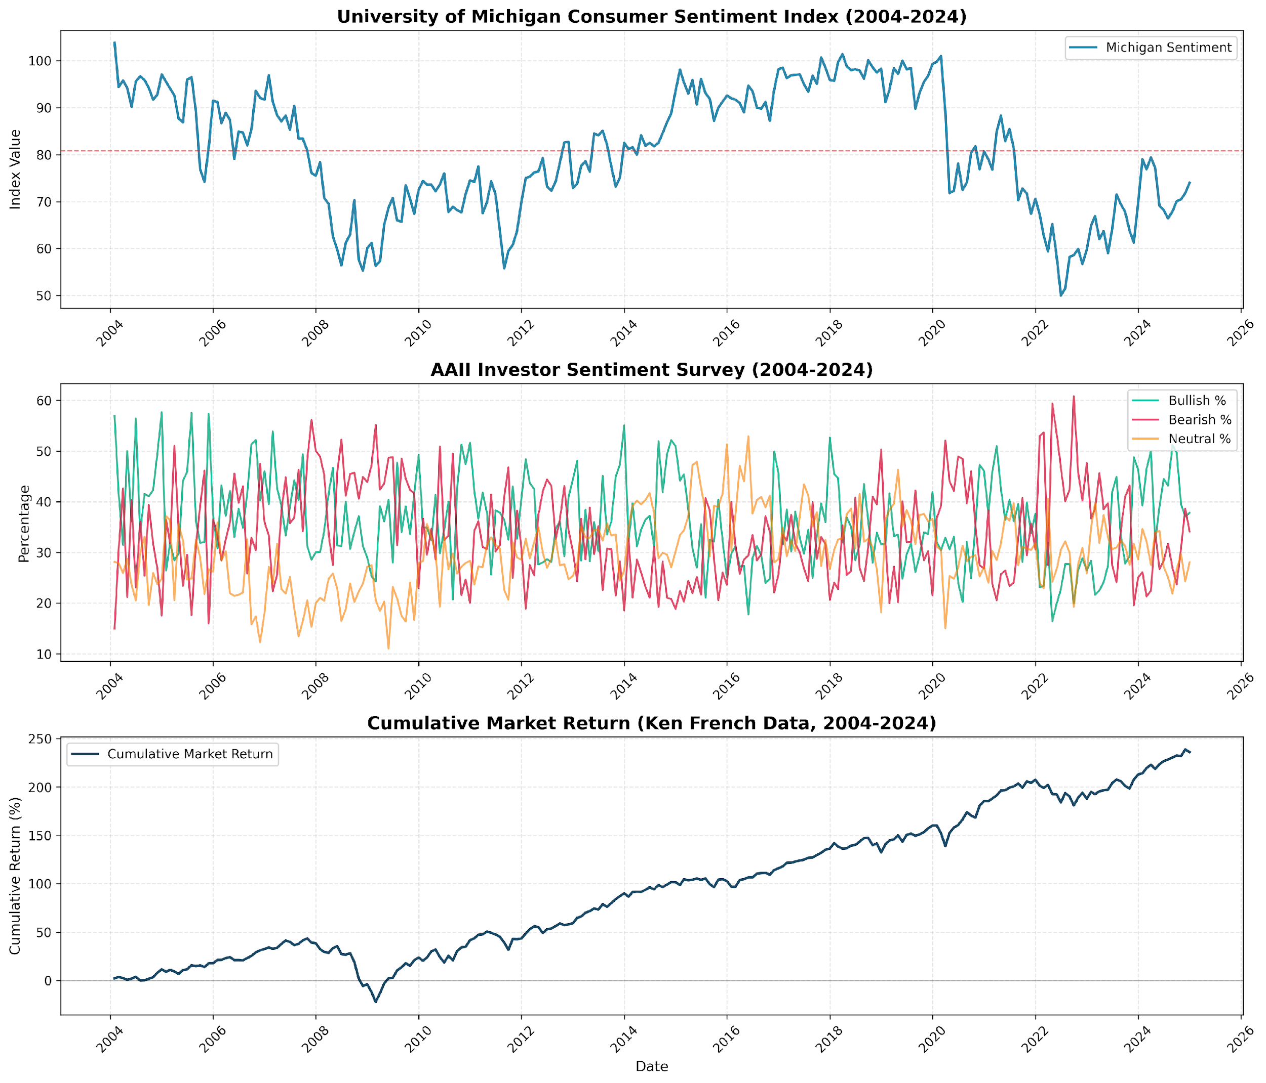
Data and sample construction
M1: Clean data was the foundation of the analysis
Three source streams
Michigan consumer sentiment from FRED
AAII weekly investor sentiment, manually collected
Kenneth R. French factor data for market controls
0
2004-
2024
Month-
end
Why month-end matters: it aligns investor mood with pricing horizons and avoids smoothing away the last signal in the month.
missing cells
analysis window
alignment rule
2nd Row Team | 3/10
Notes:
Walk through the data pipeline. Explain that the M1 result matters because the later slides rely on a merged panel with no missing cells. Emphasize the month-end AAII aggregation choice as an economic decision, not just a coding choice. If someone asks why no outlier trimming, say the crisis episodes are exactly what investors need the model to understand.

Slide 4
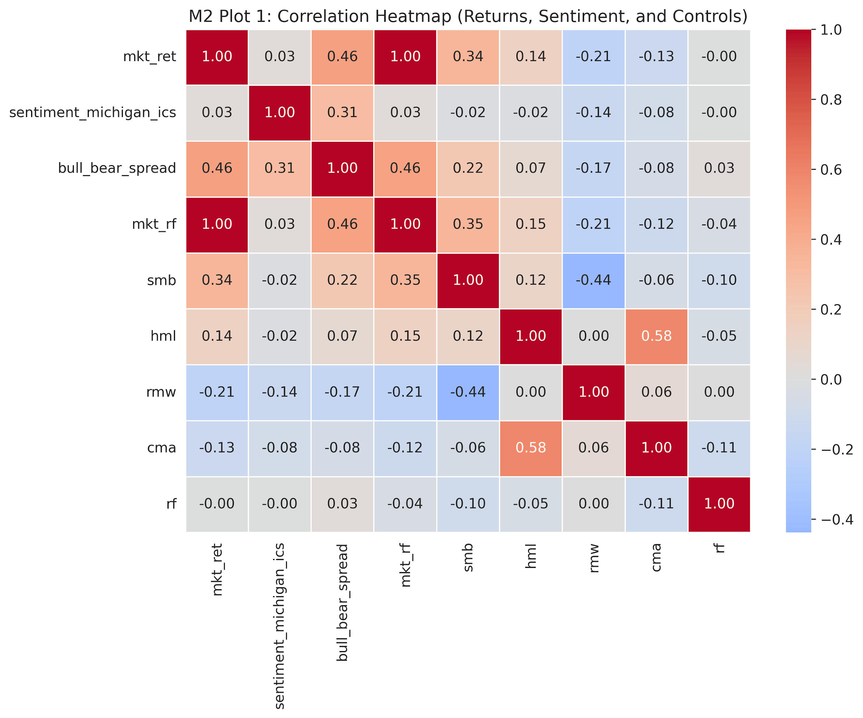
Exploratory analysis
M2: The EDA pointed to a short-run sentiment channel
Headline correlation
Market returns correlate weakly with Michigan sentiment (0.029) but more strongly with AAII bull-bear spread (0.461).
Lag structure
The largest lagged relationship appeared around 12 months, which justified testing lagged sentiment in M3.
Economic reading
Retail positioning seems to move faster than broad consumer confidence, especially near turning points.
Use sentiment as an indicator of market mood, but not as a one-variable forecast model.
2nd Row Team | 4/10
Notes:
This slide should sound like the bridge between the clean data and the regression results. Point out that the EDA did not support a simple, linear, same-month timing rule. The useful takeaway is that AAII positioning is more immediate and that lagged sentiment relationships exist, but only weakly. That is why the later models used lags and regime checks.

Slide 5
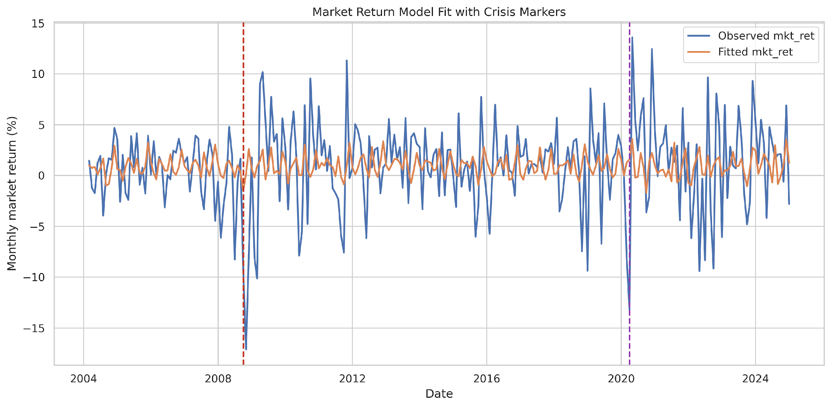
Regression failure that still mattered
M3v1: The aggregate timing model did not produce stable alpha
Direct signal
The broad-market sentiment coefficients were close to zero and statistically weak.
Interpretation
The market appears to absorb sentiment quickly, or sentiment matters only through exposure and liquidity channels.
Why this is useful
A null direct effect is not a dead end. It tells us the right question is not whether sentiment moves every monthly return, but when and where it changes risk pricing.
2nd Row Team | 5/10
Notes:
Present this carefully: do not hide the fact that the aggregate M3 model was weak. Explain that the weak result is economically meaningful because it tells us sentiment is not a simple broad-market alpha signal. That shifts the investment use case from outright timing to regime and exposure management.

Slide 6
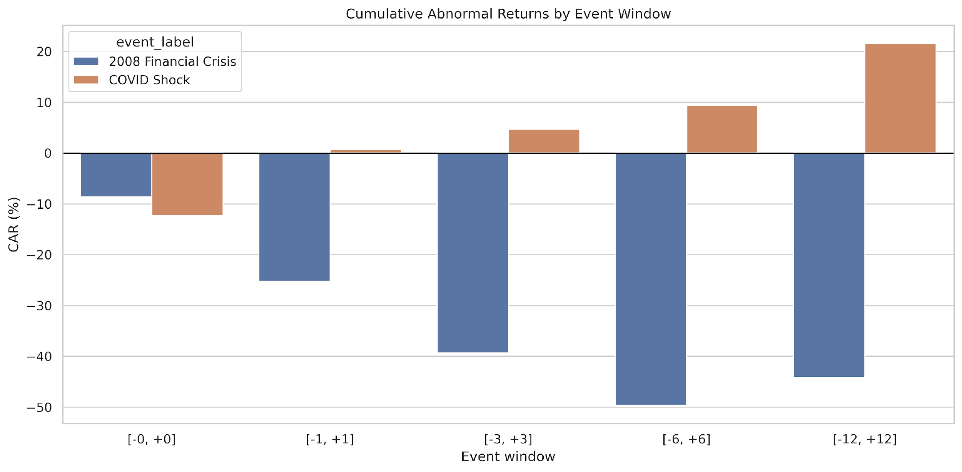
Event study
When markets break, sentiment becomes economically visible
2008 crisis
Cumulative abnormal returns were sharply negative across the event windows.
This is a repricing of default risk, funding stress, and recession odds.
COVID shock
The immediate shock was severe, but the recovery path was faster than 2008.
Markets interpreted the shock as temporary but severe, with policy support quickly priced in.
Economic message
Sentiment is most useful at inflection points, not in calm periods.
2nd Row Team | 6/10
Notes:
Use the event study to connect the macro story to investor behavior. The point is not just that crashes were negative; it is that the abnormal-return pattern shows how sentiment and risk appetite matter most when the market has to reprice uncertainty quickly. Contrast the slower, deeper 2008 drawdown with the faster COVID shock and recovery.

Slide 7
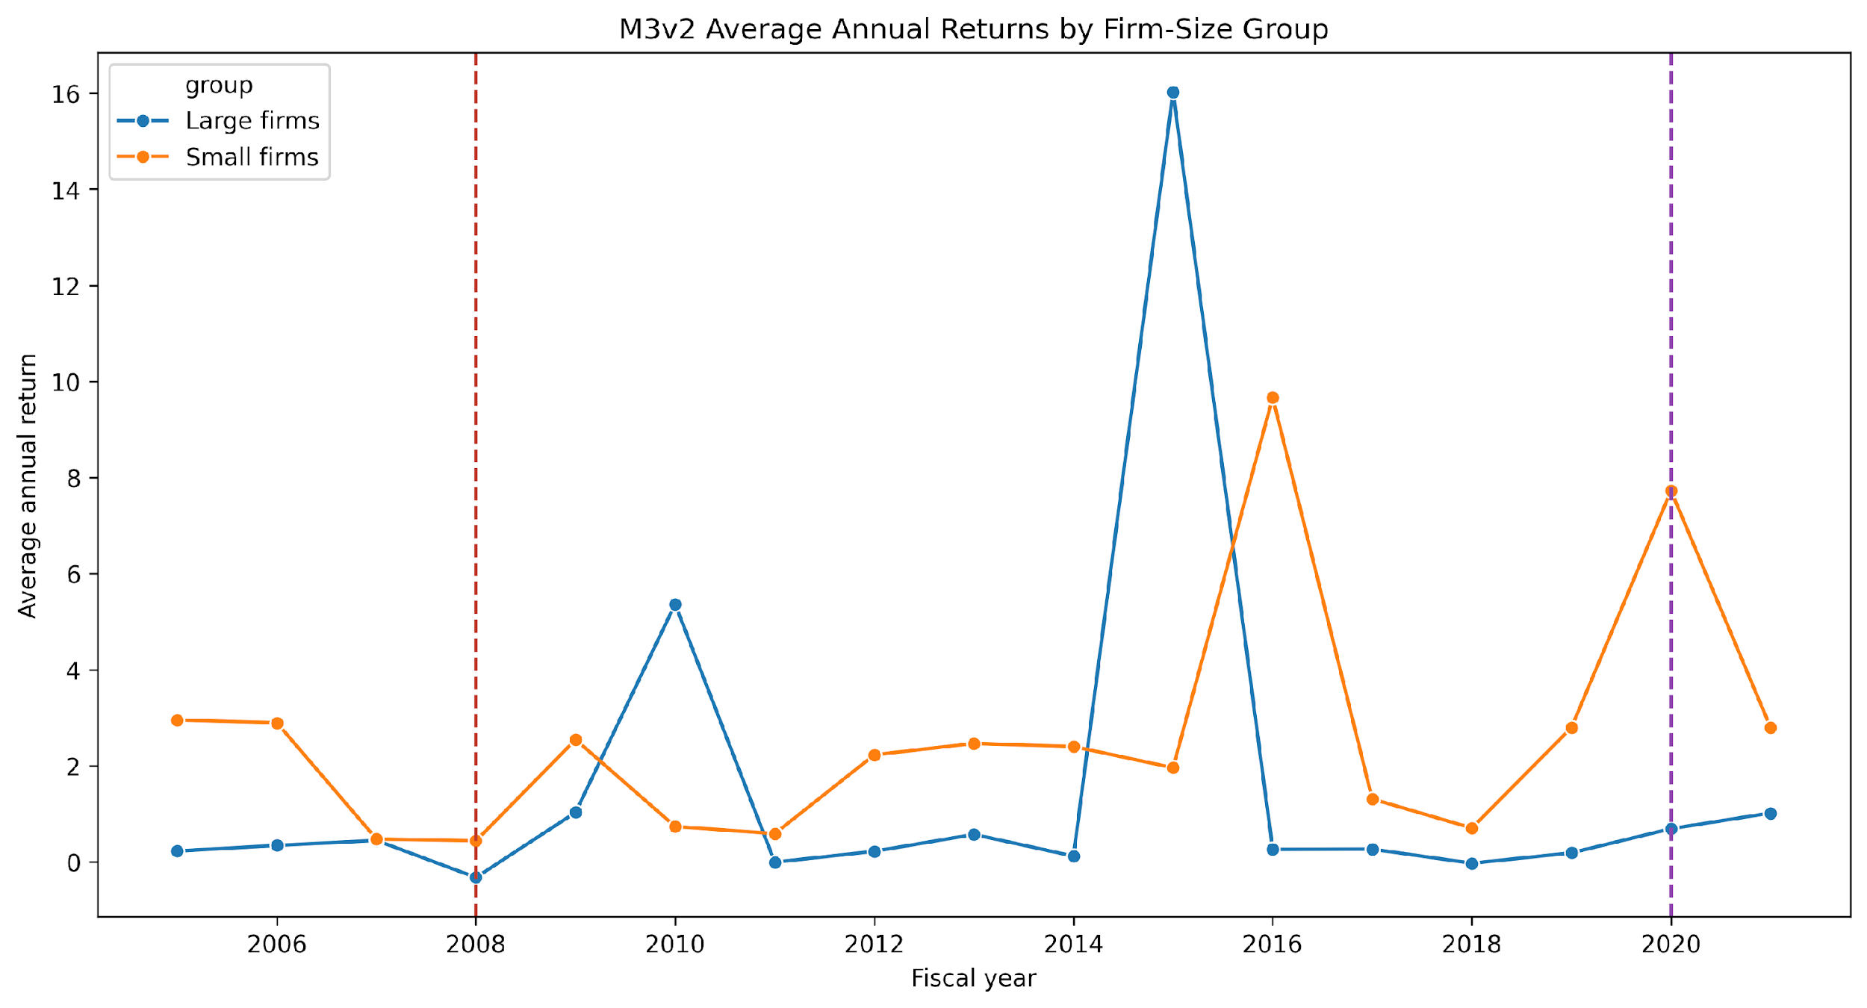
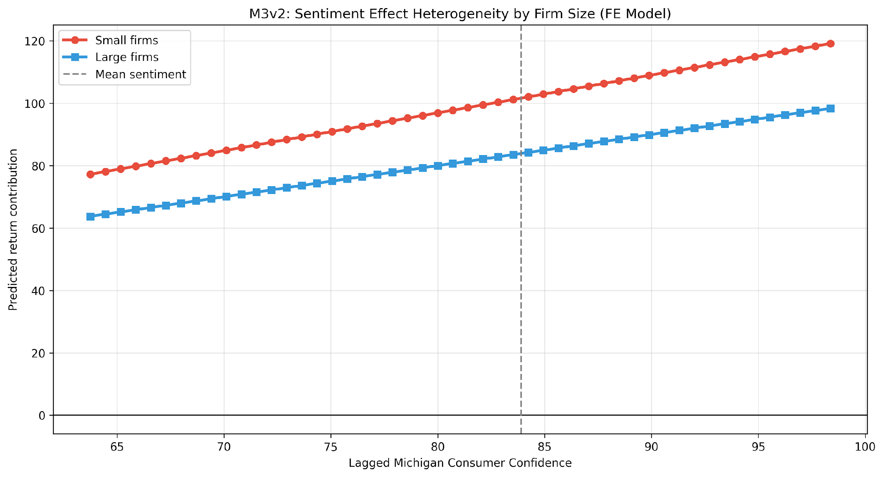
Firm-level fixed effects
M3v2: The panel model says smaller firms are more sentiment-sensitive
Economic reading
0.211*
p = 0.0418
The same sentiment shock matters more for firms with weaker financing capacity and more exposure to investor mood.
sentiment x small-firm exposure
statistical evidence
2nd Row Team | 7/10
Notes:
Explain that this is the most policy-relevant or portfolio-relevant result. The panel model is not about the market average; it is about differential exposure. That makes the coefficient economically intuitive: smaller firms are more vulnerable to financing frictions, risk aversion, and shifts in investor willingness to hold risk.

Slide 8
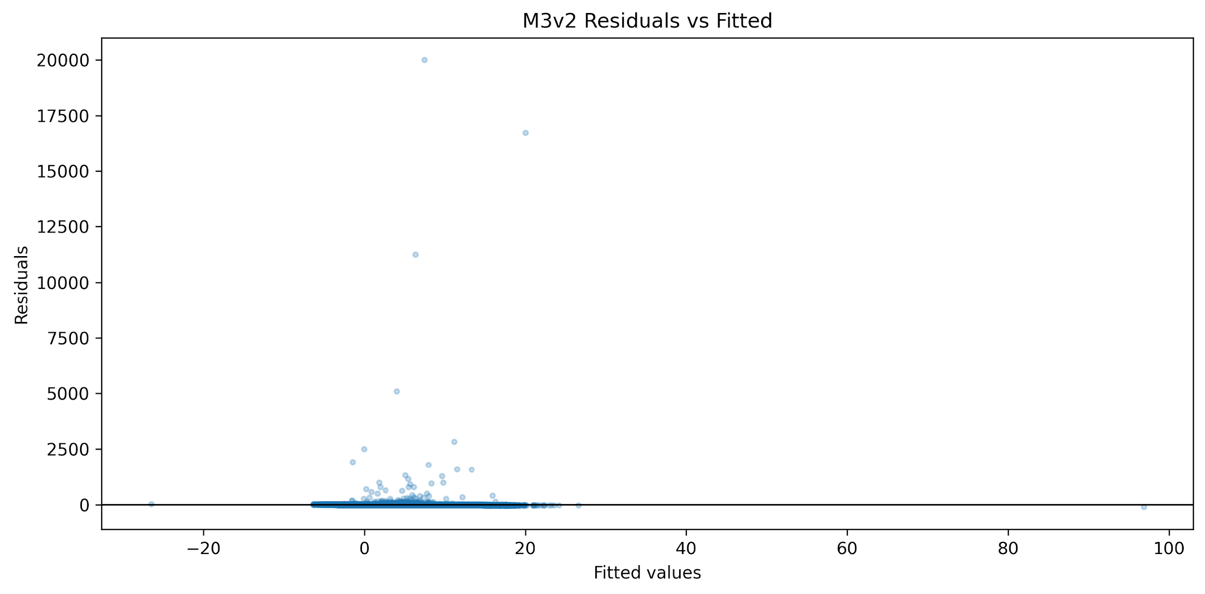
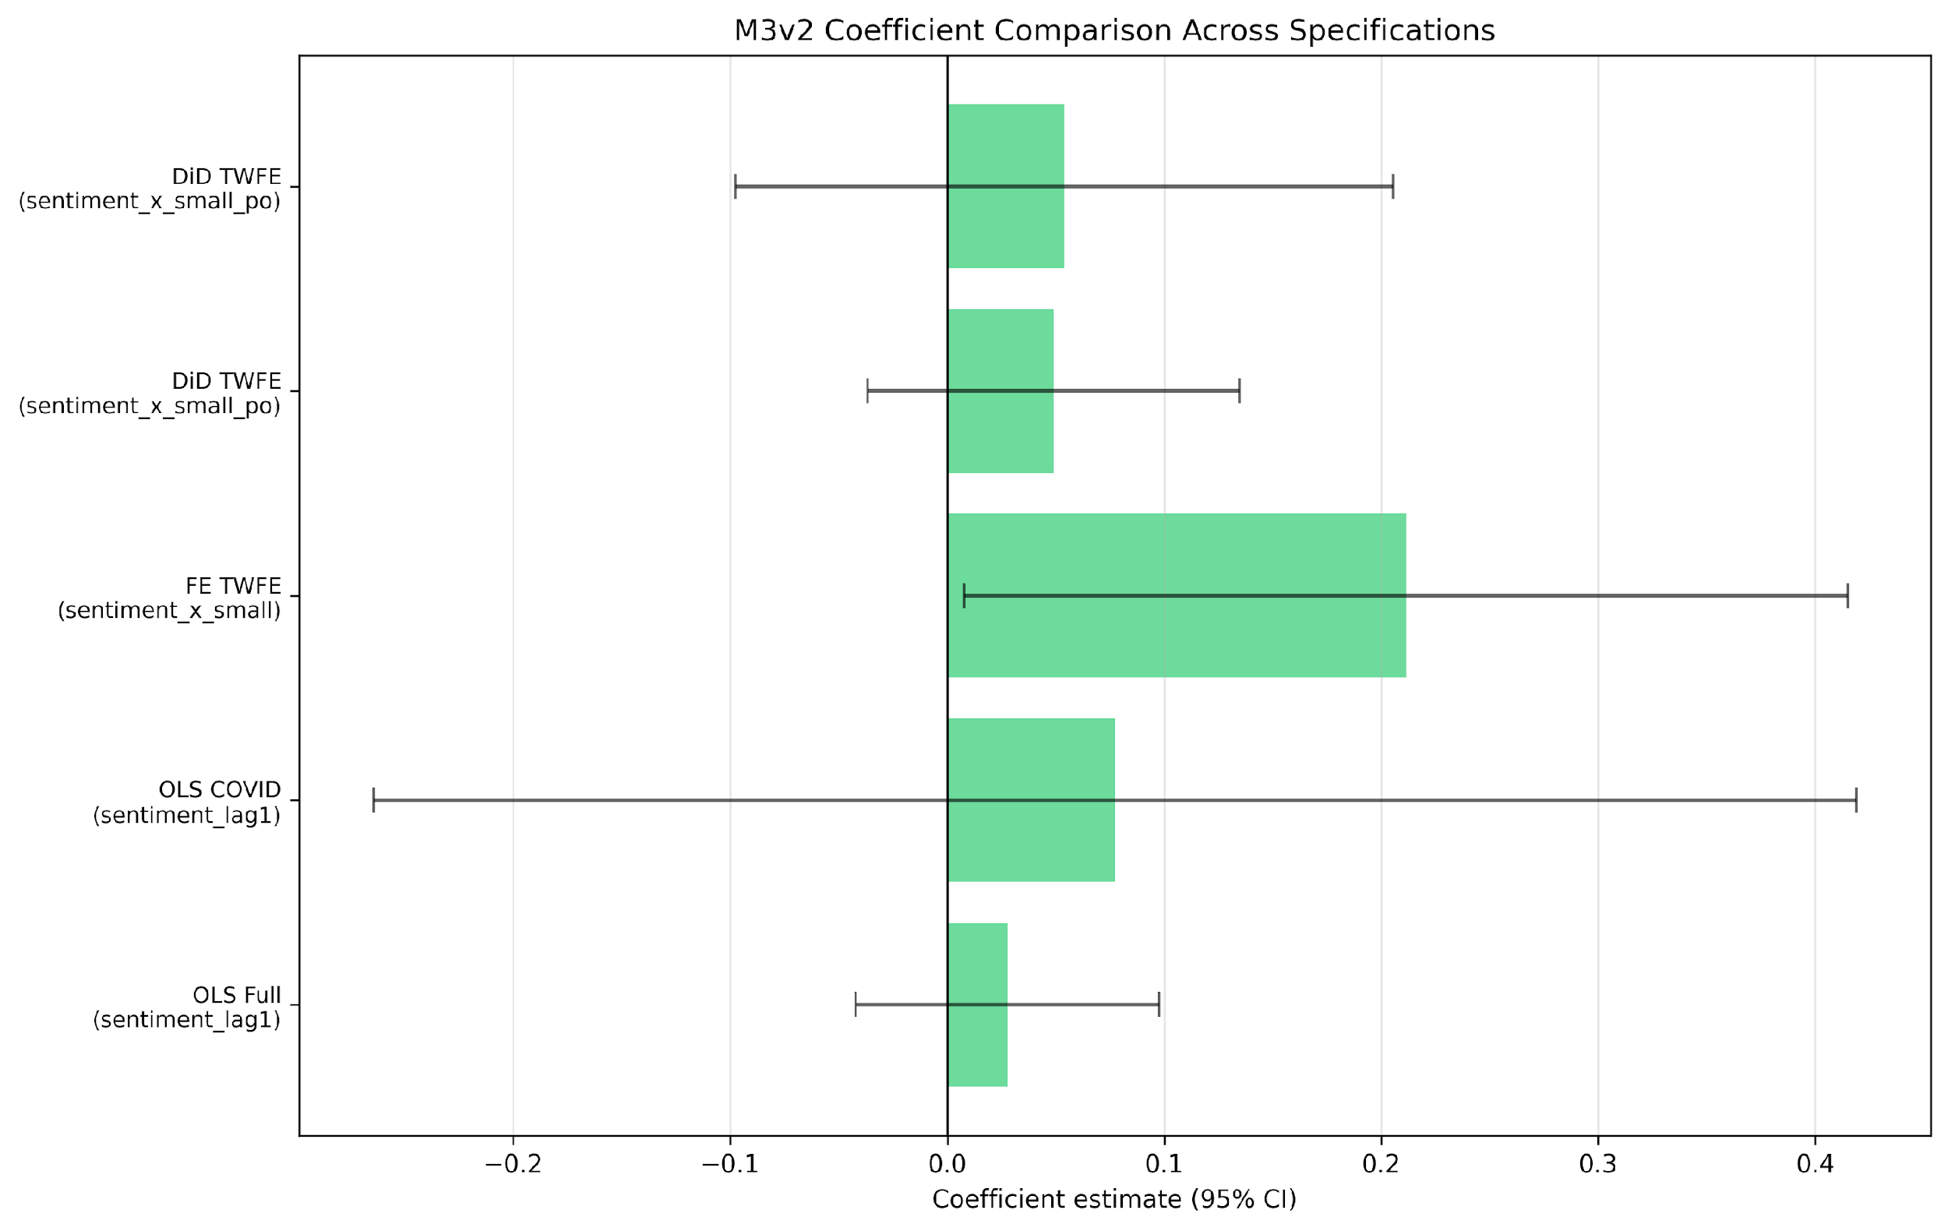
Checks and caveats
Diagnostics: the stronger story is robustness, not overclaiming
Breusch-Pagan
Max VIF
Placebo check
Bottom line
p = 0.8943
1.31
Weak pre-trend signal
No severe collinearity or heteroskedasticity red flags, but the aggregate alpha story stays weak.
2nd Row Team | 8/10
Notes:
This slide is where you show discipline. The diagnostics are important because they let you say the evidence is not being driven by obvious model pathologies. But also be honest that diagnostics are not the same as strong explanatory power. The result is robust enough to trust, yet not strong enough to overstate.

Slide 9
Recommendation: treat sentiment as a risk-budget overlay
Use it to adjust exposure, not to predict the next monthly return.
If sentiment improves after a shock
If sentiment weakens in stress
If the committee wants a hedge
Tilt modestly toward smaller, more sentiment-sensitive firms. That is where the panel model says the exposure is strongest.
Reduce exposure to the most financing-sensitive names and keep the core book diversified.
Use quality or lower leverage tilts. Sentiment itself should not be carrying all the forecasting weight.
Regime shift → allocation tilt
2nd Row Team | 9/11
Notes:
Make the recommendation concrete. The audience should leave with a decision rule, not just a statistical conclusion. Stress that the recommendation is conditional: sentiment matters most when regimes are changing, especially for small firms and financing-sensitive names. The point is disciplined risk tilting, not market timing bravado.

Slide 10

Our Story
Challenges in this Project
Producing the Pipeline
Michigan data did not want to download, sentiment scores were in different indexes, and the pipeline had to be reworked 3 times
Missing Panel Data
Given that market returns had only one data point from one “entity” per month, panel data was not applicable
Lack of Firm-Spefic Data
Market returns alone would only allow for time series analysis. In order to do regressions, firm-specific data was needed to be added to the pipeline. This caused us to redo M3 as M3v2
Notes:
This slide is where you show discipline. The diagnostics are important because they let you say the evidence is not being driven by obvious model pathologies. But also be honest that diagnostics are not the same as strong explanatory power. The result is robust enough to trust, yet not strong enough to overstate.

Slide 11
Bottom line
Sentiment is a regime signal, not a magic timing machine.
That is the most honest and most useful conclusion for an investment committee.
Questions?
2nd Row Team | 11/11
Notes:
Close by repeating the practical takeaway: sentiment helps the committee manage risk, but it does not give a stable market-timing edge on its own. End with confidence, not hype. If there is time, invite questions about the M3 failure, because that is where the most honest methodological discussion will come from.

